Slide 1

Clergy Abuse
Awareness & Response
Recognize the signs. Protect the vulnerable. Support survivors. Report safely.
Created by Oklahoma Child Wellbeing
www.okchildwellbeing.org
Notes:
Created by Oklahoma Child Wellbeing | www.okchildwellbeing.org

Slide 2
What clergy abuse is
It is not “church drama.” It is a power-and-safety issue.
“
Clergy abuse happens when spiritual authority is used to control, exploit, silence, or harm.
IT MAY INCLUDE
•
Sexual abuse, assault, grooming, or coercion
•
Spiritual manipulation framed as “God’s will”
Clergy Abuse Short Video
•
Threats, shame, retaliation, or public humiliation
•
Cover-ups that protect reputation over people
Created by Oklahoma Child Wellbeing | www.okchildwellbeing.org
02
Notes:
Created by Oklahoma Child Wellbeing | www.okchildwellbeing.org

Slide 3
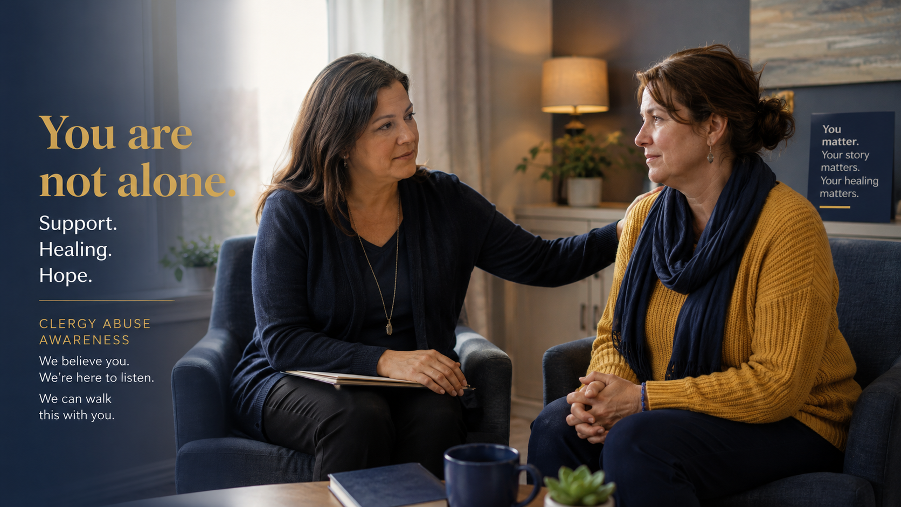
Why “adult” does not erase abuse
A person can be grown and still be groomed, coerced, or spiritually manipulated.
POWER IMBALANCE
•
Pastors and ministry leaders hold spiritual, social, and community authority.
•
Counseling, prayer, employment, belonging, and reputation can create dependency.
•
When secrecy enters the relationship, the imbalance becomes dangerous.
A healthy leader does not need secrecy to help someone.
Stockholm Syndrome
14:57 minutes through 17:10 minutes
“
Created by Oklahoma Child Wellbeing | www.okchildwellbeing.org
03
Notes:
Created by Oklahoma Child Wellbeing | www.okchildwellbeing.org

Slide 4
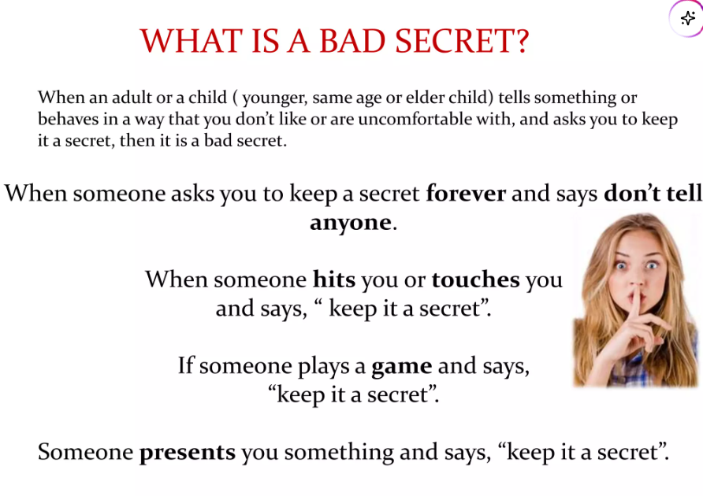
How grooming often begins
Most abuse does not begin with the obvious. It often begins with boundary violations.
1
2
3
4
5
Access
Secrecy
Dependency
Isolation
Escalation
Private texting, special attention, invitations, rides, or favors
“Don’t tell anyone.” “They would not understand.”
Counseling, prayer, help, money, employment, or ministry access
Distance from spouse, family, friends, or outside support
Physical contact, sexual pressure, emotional control, retaliation
If a relationship with a spiritual authority requires secrecy, slow down and get outside support.
Created by Oklahoma Child Wellbeing | www.okchildwellbeing.org
04
Notes:
Created by Oklahoma Child Wellbeing | www.okchildwellbeing.org

Slide 5
Red flags in a leader
Look for patterns, not one isolated awkward moment.
BOUNDARY VIOLATIONS
COERCIVE PATTERNS
Late-night private messages or “special” access
“God told me” pressure or spiritualized intimacy
•
•
Sexual or marital disclosures during counseling/prayer
Requests for secrecy or loyalty to the leader
•
•
Gifts, money, jobs, housing, travel, or favors
Blame-shifting when confronted
•
•
•
Testing physical boundaries, then minimizing discomfort
•
Retaliation, public shame, or threats after boundaries
Red flag question: Does the leader respect your freedom — or punish you when you say no?
Created by Oklahoma Child Wellbeing | www.okchildwellbeing.org
05
Notes:
Created by Oklahoma Child Wellbeing | www.okchildwellbeing.org

Slide 6

Red flags in the system
Unsafe systems protect the brand. Safe systems protect people.
WATCH INSTITUTIONAL RESPONSE
•
Concerns are called gossip before they are reviewed.
•
Victims are pressured to forgive before they are protected.
Reports are handled only internally or quietly buried.
•
•
The accused is moved, restored, or given a vague sabbatical.
Staff or witnesses fear retaliation for speaking up.
•
Created by Oklahoma Child Wellbeing | www.okchildwellbeing.org
06
Notes:
Created by Oklahoma Child Wellbeing | www.okchildwellbeing.org

Slide 7
Recent case-study patterns
The details change. The accountability failures repeat.
CASE STUDY: ANTHONY ODIONG
PATTERN: TRANSPARENCY FIGHTS
A Texas jury convicted and a court sentenced former priest Anthony Odiong to life in prison in 2026. Guardian reporting described years of complaints, delayed action, transfers, and spiritual manipulation allegations before criminal accountability.
Seton Hall/McCarrick litigation shows another pattern: survivors seeking access to internal reports and institutions arguing privilege or confidentiality. Courts may release some policy material while shielding other sections.
anthony-odiong-sexual-abuse-catholic-church
Seton-hall-sex-abuse-survivors
What to learn: documentation, outside reporting, and survivor safety cannot depend on the institution accused of failing to act.
Created by Oklahoma Child Wellbeing | www.okchildwellbeing.org
07
Notes:
Created by Oklahoma Child Wellbeing | www.okchildwellbeing.org

Slide 8
If it happened — or is happening now
Safety first. Documentation second. Public decisions later.
1
Get safe
Call 911 if there is immediate danger.
2
Tell outside support
Choose someone not dependent on the church system.
3
Preserve evidence
Save texts, emails, voicemails, social posts, receipts, and timelines.
4
Avoid private meetings
Take a support person and ask for written communication.
5
Report when safety/crime is involved
Civil reporting matters when minors, assault, threats, stalking, or exploitation may be involved.
You do not need a perfect timeline before asking for help.
Created by Oklahoma Child Wellbeing | www.okchildwellbeing.org
08
Notes:
Created by Oklahoma Child Wellbeing | www.okchildwellbeing.org

Slide 9

How to report and get help
Use civil systems when safety, crime, minors, or vulnerable adults may be involved.
OKLAHOMA
Emergency: 911
Child abuse or vulnerable adult abuse: 1-800-522-3511
Oklahoma SafeLine: 1-800-522-SAFE (7233)
NATIONAL SEXUAL ASSAULT SUPPORT
RAINN National Sexual Assault Hotline: 1-800-656-HOPE (4673)
Online chat: rainn.org | Text HOPE to 64673
Created by Oklahoma Child Wellbeing | www.okchildwellbeing.org
09
Notes:
Created by Oklahoma Child Wellbeing | www.okchildwellbeing.org

Slide 10
How to support someone you love
Believe enough to protect. Do not make them carry the institution.
SAY THIS
DO NOT SAY THIS
•
“I believe you.”
•
“But he is such a good pastor.”
•
“This was not your fault.”
•
“Are you sure?”
•
“You do not have to handle this alone.”
•
“Don’t hurt the church.”
•
“I will help you preserve evidence.”
•
“You need to forgive.”
•
“I will not pressure you to forgive, stay silent, or go public.”
•
“You were an adult.”
Created by Oklahoma Child Wellbeing | www.okchildwellbeing.org
10
Notes:
Created by Oklahoma Child Wellbeing | www.okchildwellbeing.org

Slide 11

What safe systems do
Protection requires truth, records, and independent pathways.
A SAFER CHURCH OR MINISTRY SHOULD
•
Use written safeguarding policies and clear boundaries.
•
Provide multiple reporting pathways, including outside options.
•
Remove access while credible concerns are reviewed.
•
Use independent investigation when leadership is implicated.
•
Protect survivors and witnesses from retaliation.
•
Cooperate with law enforcement and preserve evidence.
Forgiveness does not replace safety. Prayer does not replace reporting.
Created by Oklahoma Child Wellbeing | www.okchildwellbeing.org
11
Notes:
Created by Oklahoma Child Wellbeing | www.okchildwellbeing.org

Slide 12
Sources & use note
This deck is for education, prevention, and survivor support.
Sources used for factual anchors
Use note
•
The Guardian, June 2026 reporting on Anthony Odiong conviction and institutional response.
This presentation is not legal advice, therapy, or a final investigative conclusion. It is a public education resource. If someone is in immediate danger, call 911. If a child or vulnerable adult may be abused or neglected in Oklahoma, call 1-800-522-3511.
•
Baylor Adult Clergy Sexual Abuse Advocacy & Research Collaborative.
•
RAINN National Sexual Assault Hotline resources.
•
Oklahoma DHS abuse and neglect reporting guidance.
•
Jersey Vindicator / EWTN / public reporting on Seton Hall disclosure litigation.
Created by Oklahoma Child Wellbeing
www.okchildwellbeing.org
Created by Oklahoma Child Wellbeing | www.okchildwellbeing.org
12
Notes:
Created by Oklahoma Child Wellbeing | www.okchildwellbeing.org

